Slide 1

Daryl’s Movie Emporium
SWEN 5236 Midterm

Slide 2
Contents
Section 1
Section 2
Features and screen shots
Code Samples

Slide 3
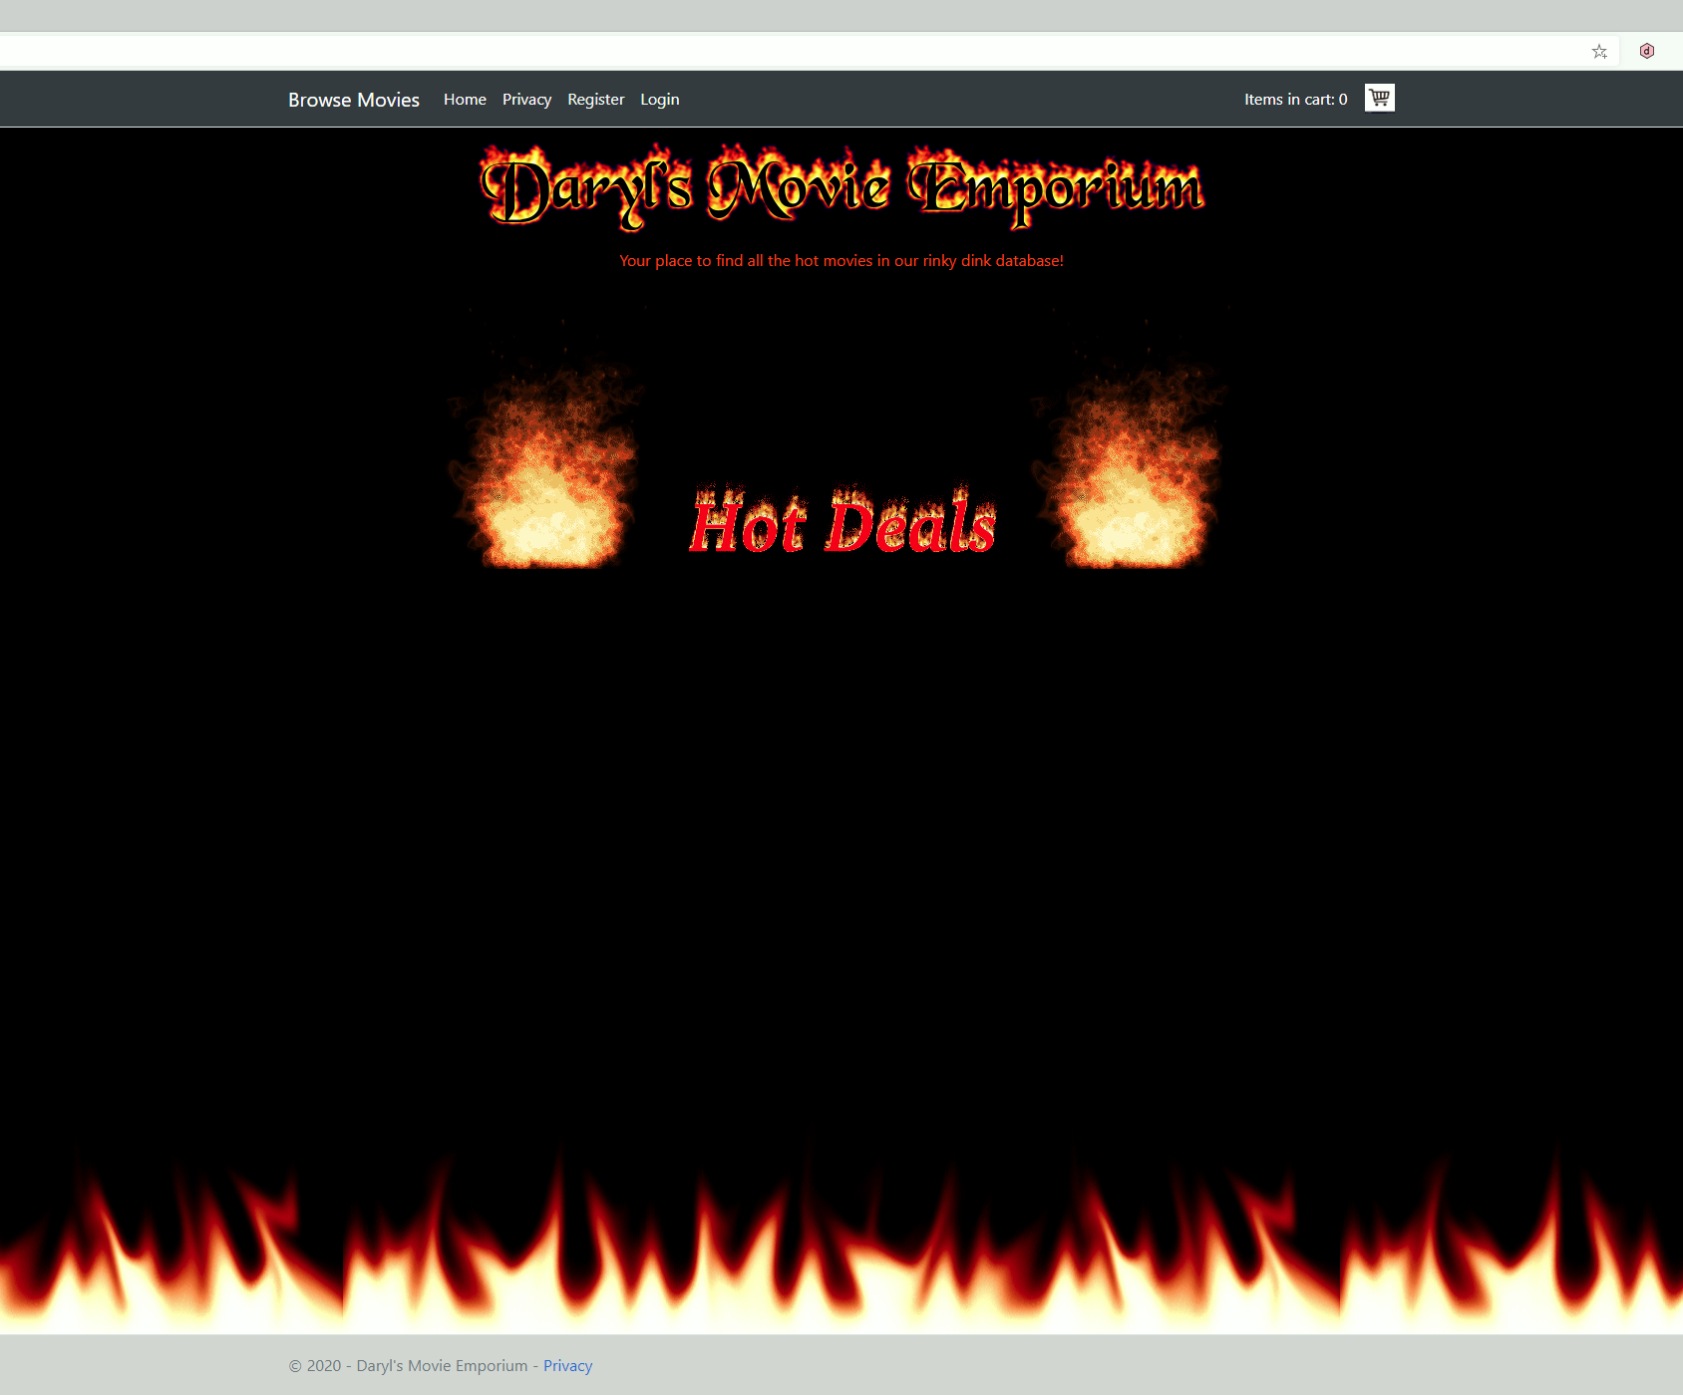
Section 1 – Feature List
HTTPS Secure Sockets
User support
2 Factor Authentication
Pages locked behind logins
Database administration via web interface and bound to an administrative account
Classic look with modern web design (CSS, JavaScript, jQuery, ASP.Net Core)
Modal displays for trailers and plot descriptions.
Cart item display in header
Shopping cart with automatic discount business logic.
Separate billing and shipping address support.
Form validation for required inputs.
Printable Invoice (print button does not show up on invoice)
Session capture using cookies
Session is cleared upon completion of purchase, login or logout, or after a 10-minute timeout.

Slide 4
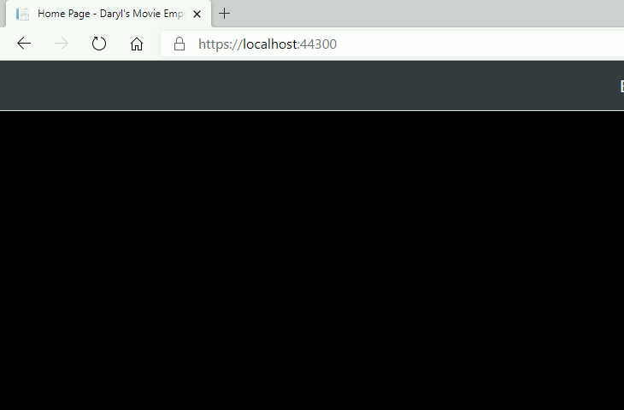
HTTP Secure Socket
Application uses HTTPS. For dev it is a self signed certificate. In production it would use a certificate from a root provider such as Microsoft, Thawte, etc.

Slide 5
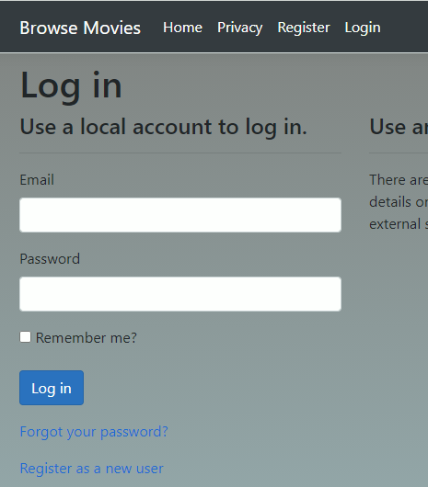
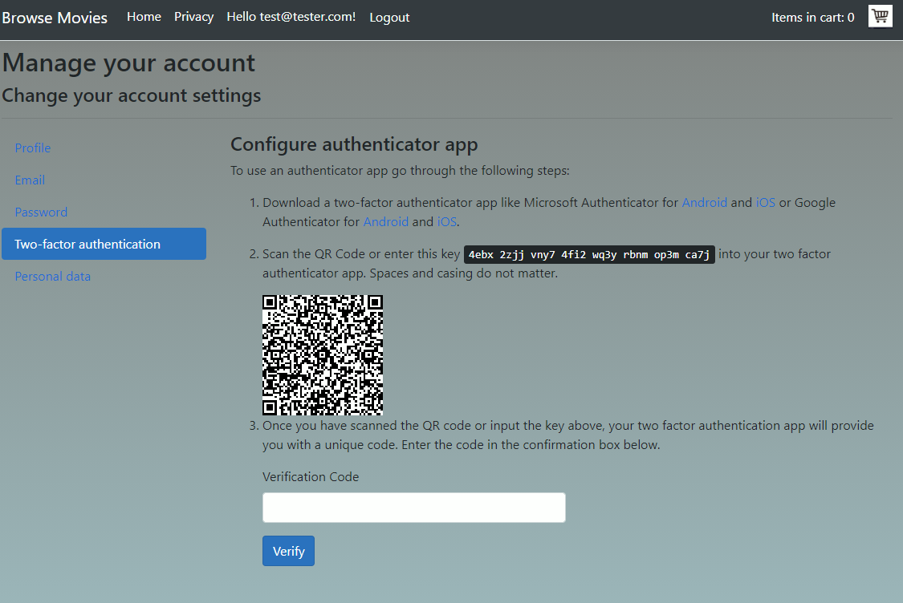
User Support with 2fa
ASP.Net Identity service used to support website users.
2 Factor Authentication

Slide 6
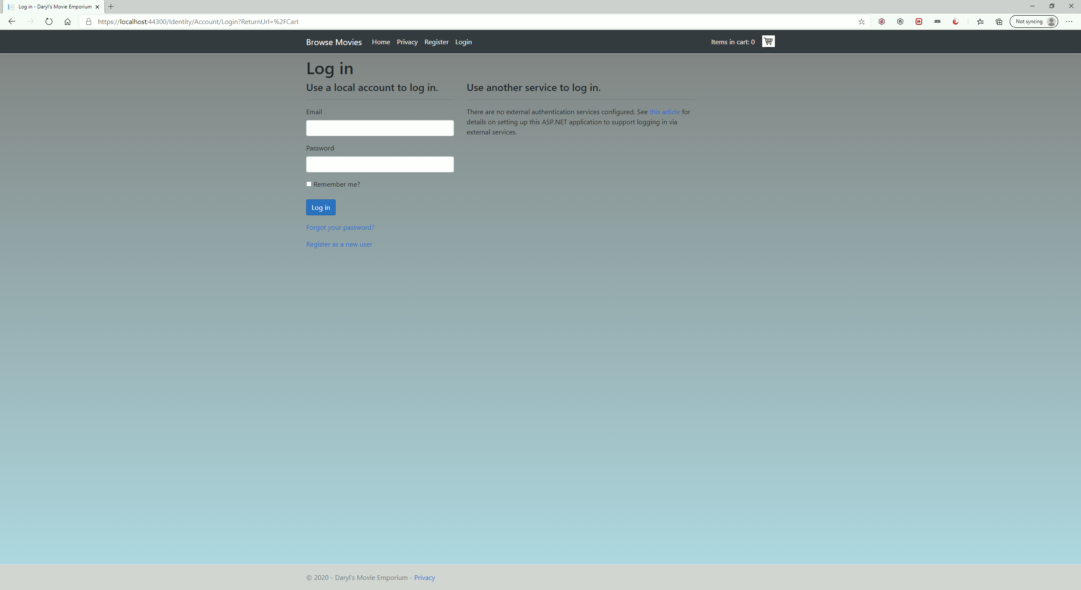
Pages locked behind logins
Unable to access cart and other pages without prior login.
Separate database for user account information from the product, a.k.a. movies database.

Slide 7
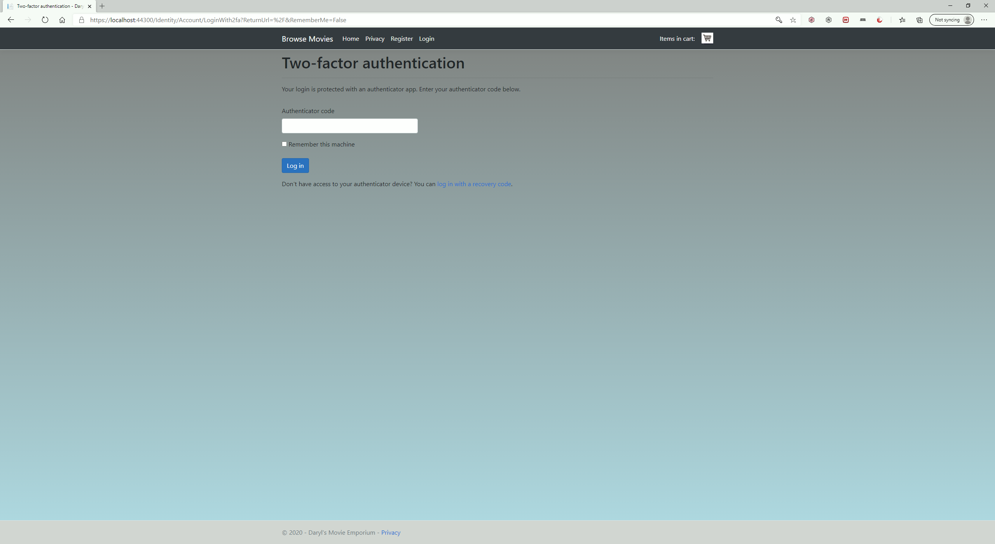
2 Factor Authentication
App supports, but does not require, 2 factor authentication for users.
Sample user accounts both with and without 2 factor enabled.

Slide 8
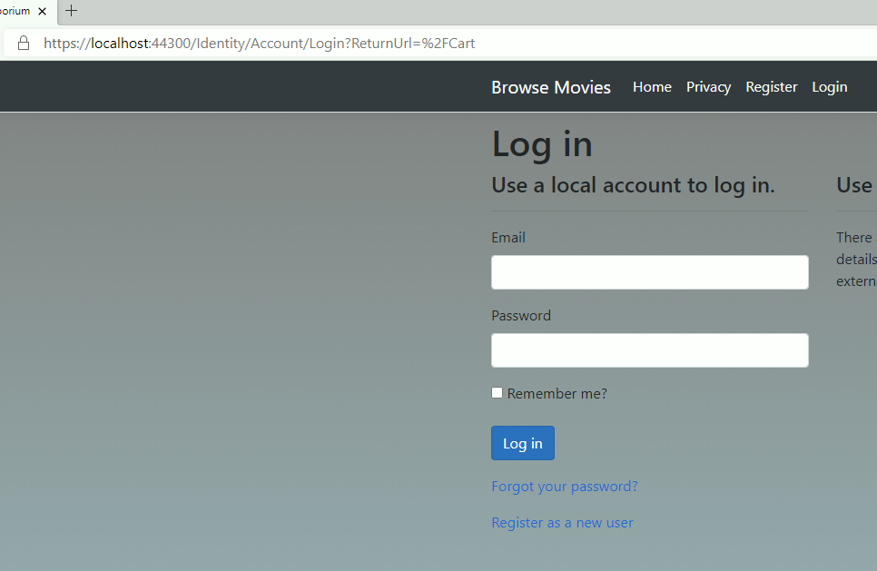
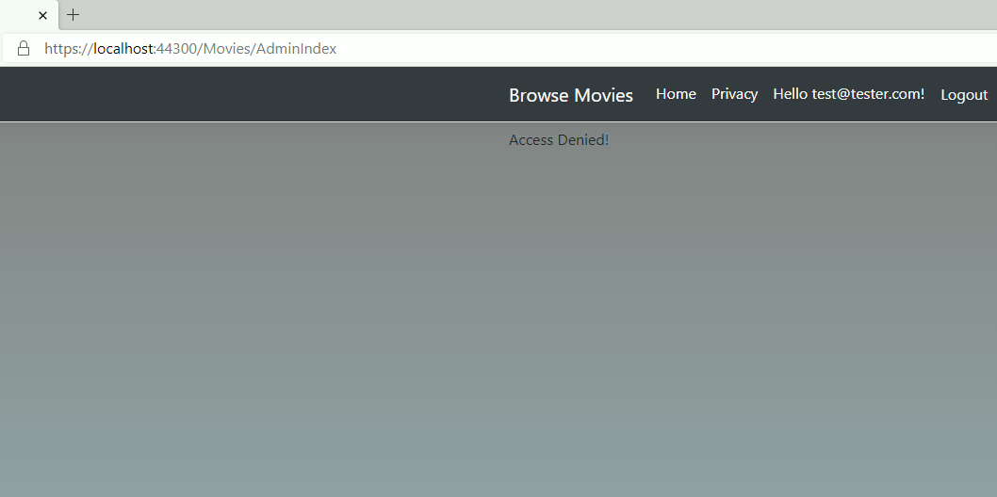
Pages locked behind login
Some pages require a user to be logged in.
Some pages require a specific user to be logged in.

Slide 9
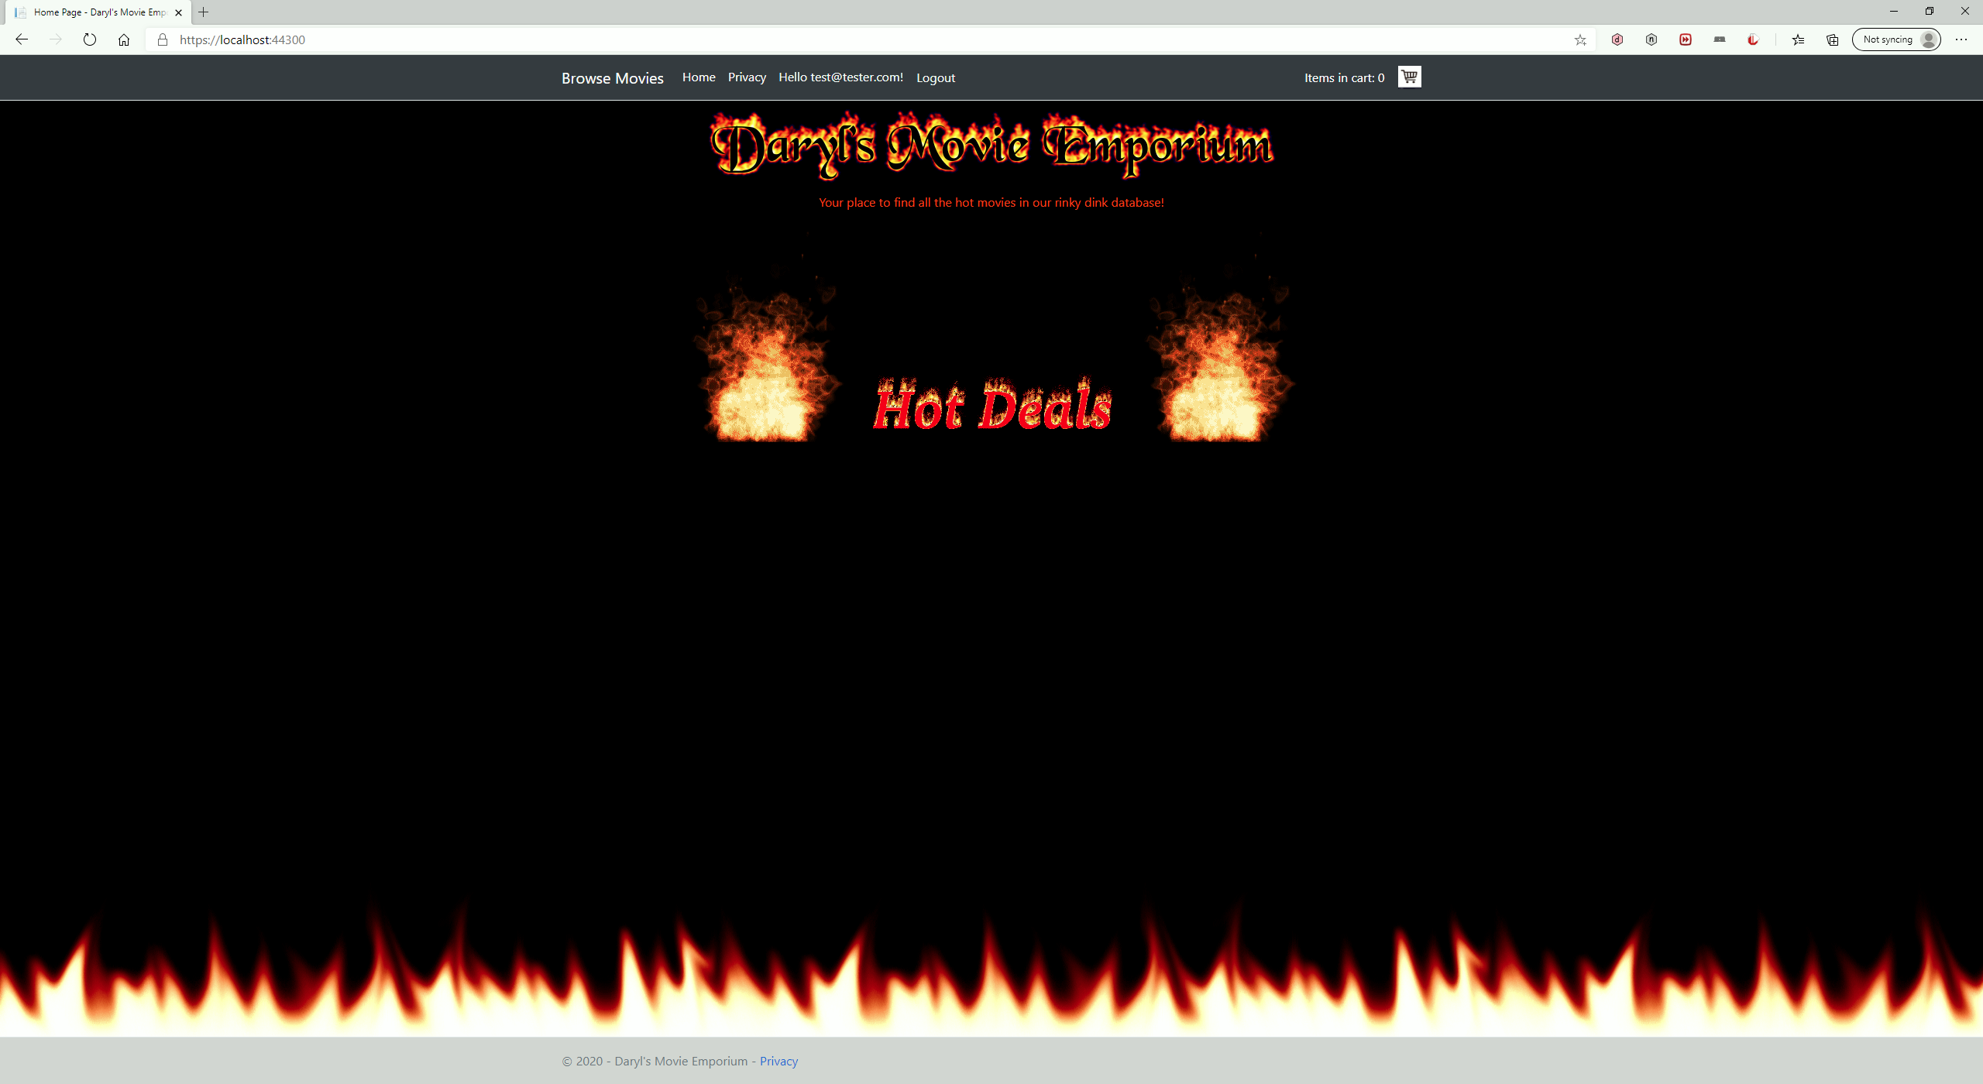
Classic look with modern web design (CSS, JavaScript, jQuery, ASP.Net Core)

Slide 10
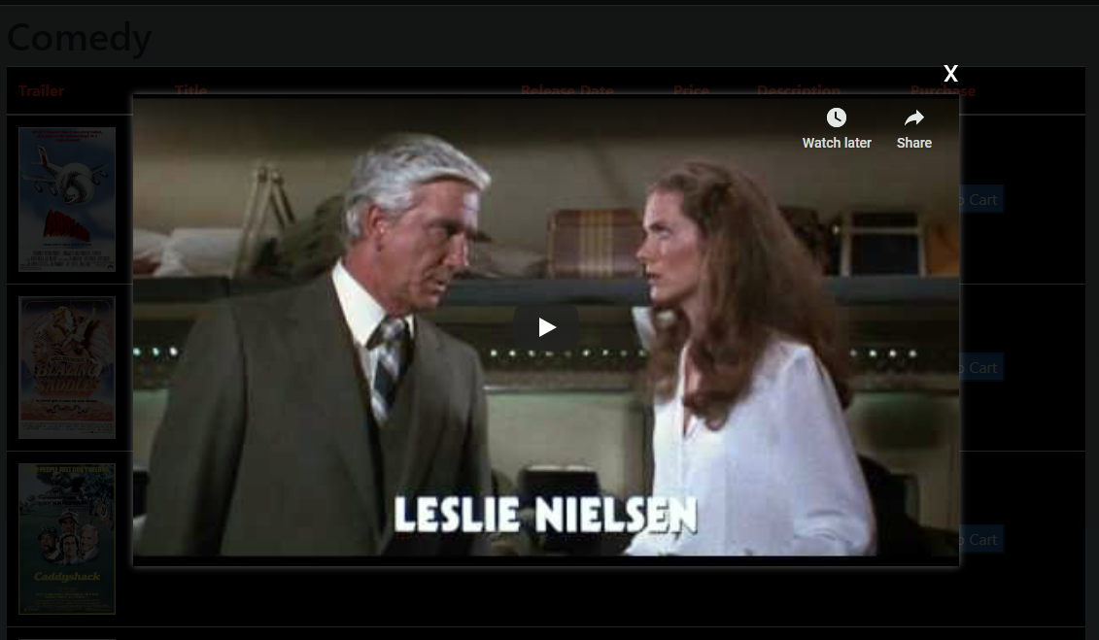
Modal display for trailer

Slide 11
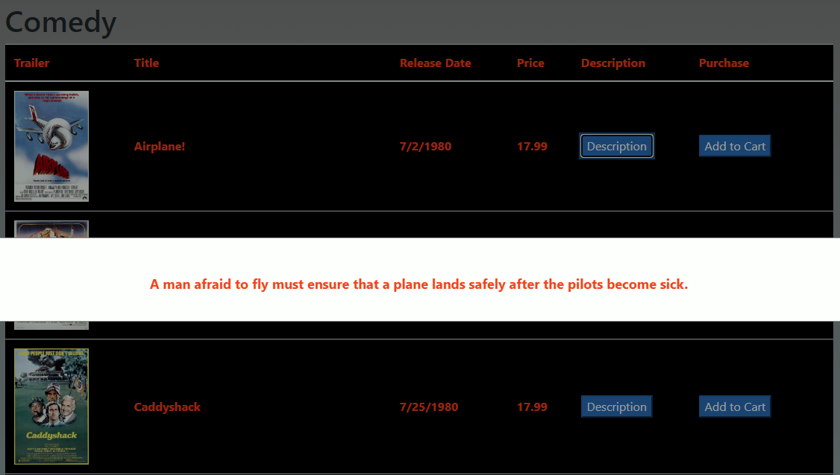
Modal display for plot description

Slide 12
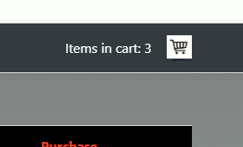
Shopping cart
Shopping cart counter displays in header bar which is fixed in position allowing the content to scroll behind it.

Slide 13
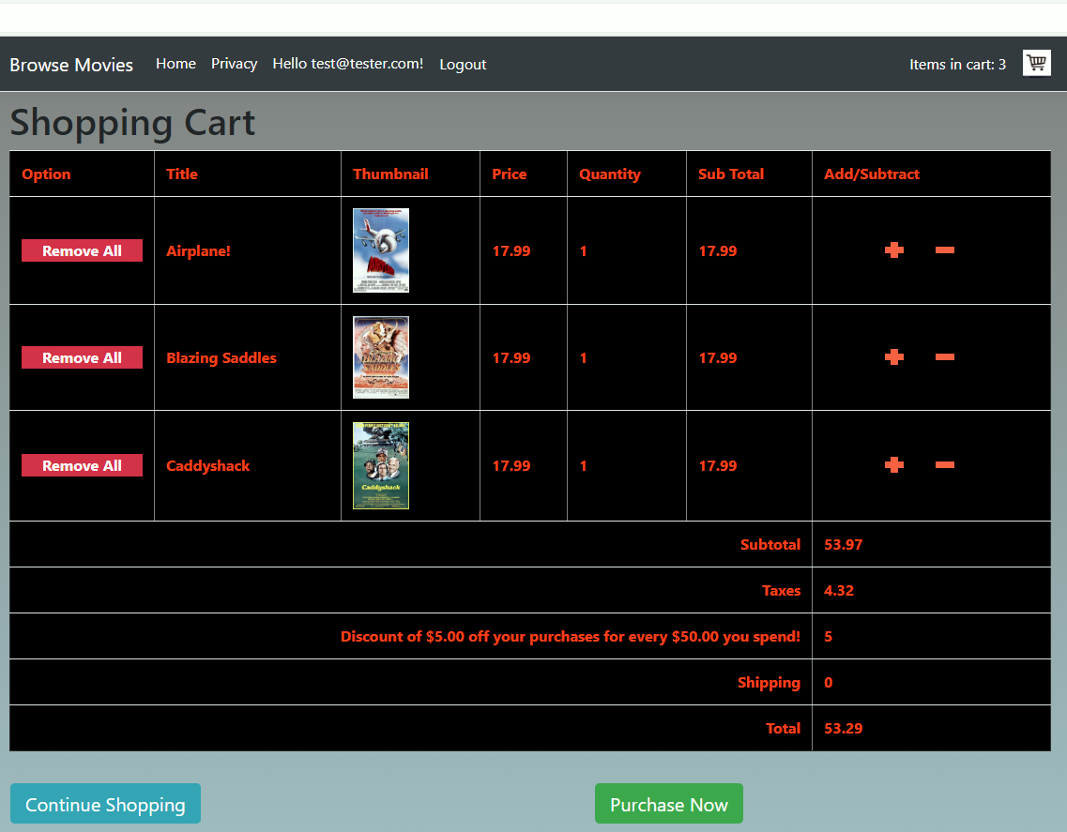
Shopping cart
Shopping cart has automatic discount business logic.

Slide 14
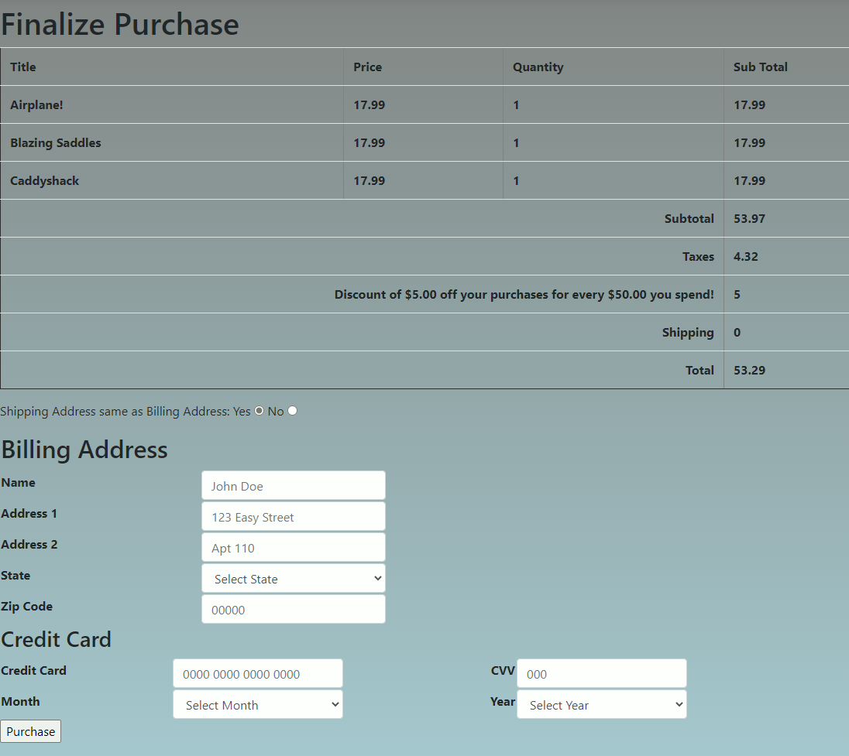
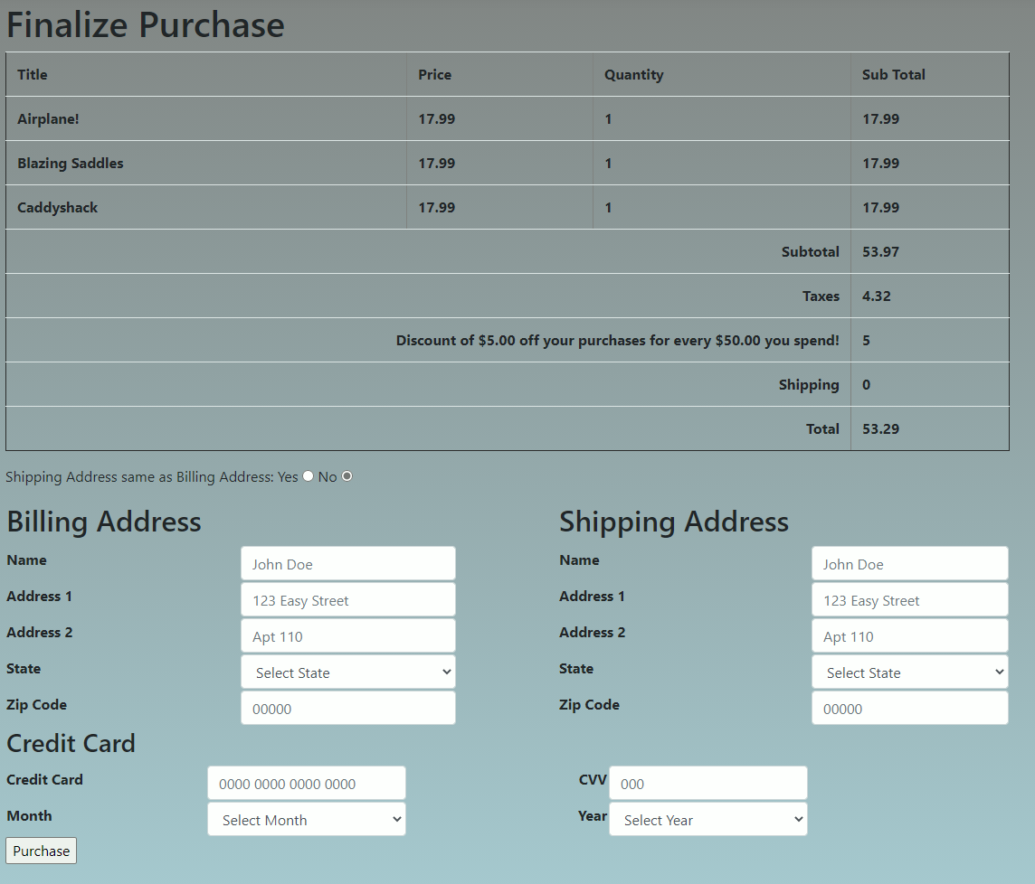
Separate Billing and Shipping Address

Slide 15
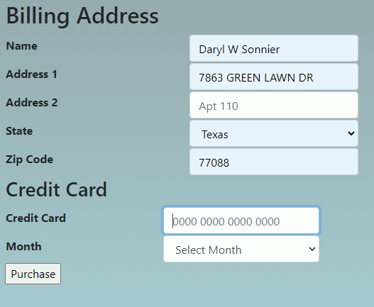
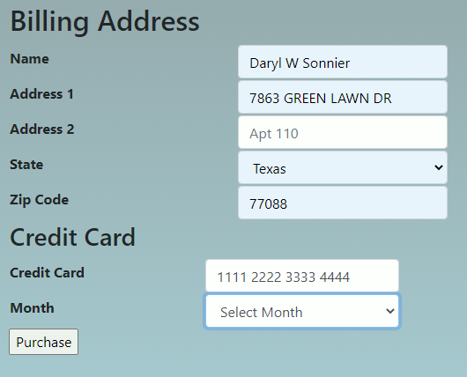
Form Validation highlights missing data

Slide 16
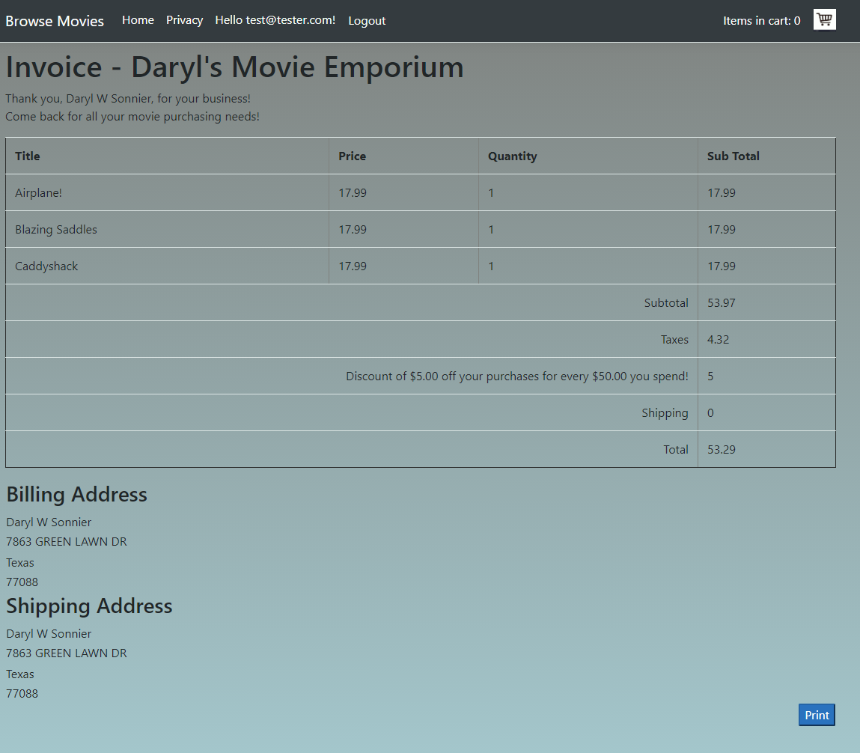
Printable Invoice
Invoice is generated. When printing the print button and the header are hidden from the print job.

Slide 17
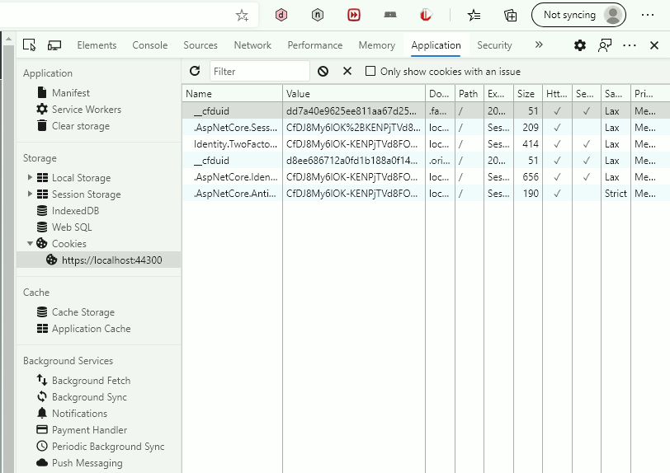
Session capture
Session data for the shopping cart, login, authentication, etc. is handled via cookies.
Login, Logout, purchase, and 10-minute timeout all clear the cart session.

Slide 18
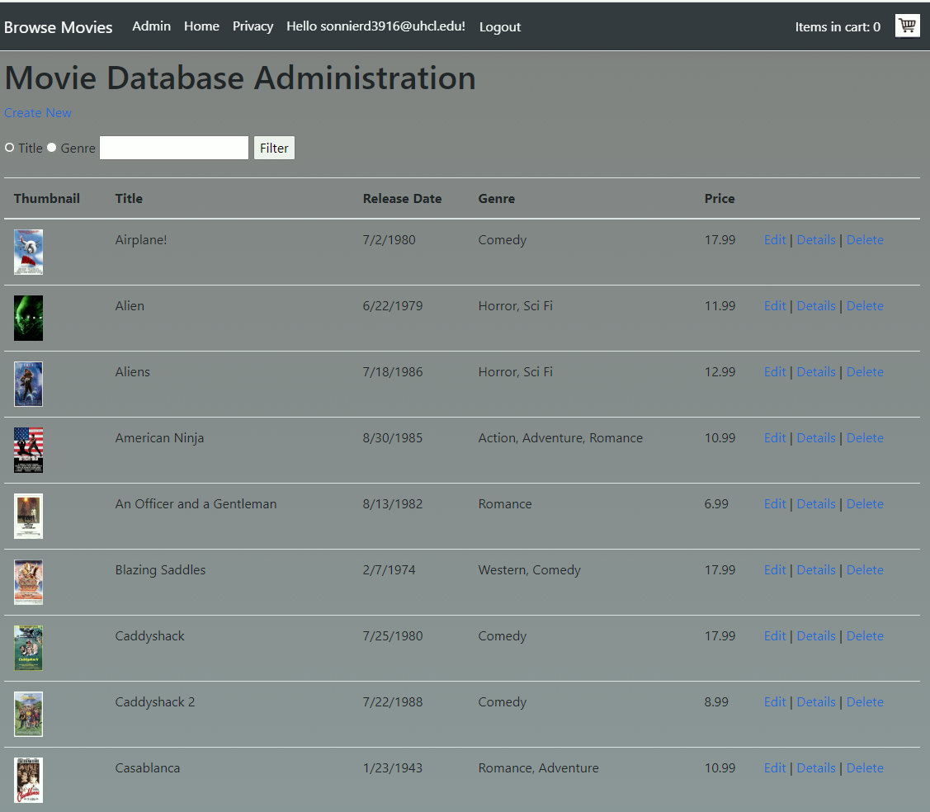
Database Administration
Movies database administrated via web application.

Slide 19
Section 2
Code Samples

Slide 20
HTTPS Secure Sockets
public void Configure(IApplicationBuilder app, IWebHostEnvironment env)
{
if (env.IsDevelopment())
{
app.UseDeveloperExceptionPage();
app.UseDatabaseErrorPage();
}
else
{
app.UseExceptionHandler("/Home/Error");
// The default HSTS value is 30 days. You may want to change this for production scenarios, see https://aka.ms/aspnetcore-hsts.
app.UseHsts();
}
app.UseHttpsRedirection();
app.UseStaticFiles();
app.UseRouting();
app.UseAuthentication();
app.UseAuthorization();
app.UseSession();
app.UseEndpoints(endpoints =>
{
endpoints.MapControllerRoute(
name: "default",
pattern: "{controller=Home}/{action=Index}/{id?}");
endpoints.MapRazorPages();
});
}
The application configure method indicates to use Hsts and HttpsRedirection forcing browsers to use HTTPS rather than HTTP.

Slide 21
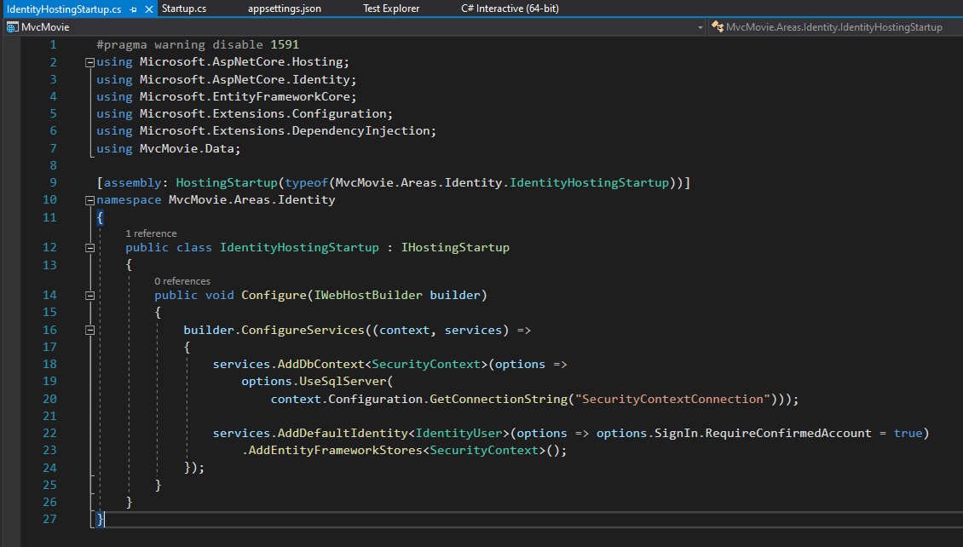
User Support
User support has been added via the ASP.Net Identity service.
There are numerous C# and CSHTML pages added via scaffolding that pertain to this service.
This was mostly left default; however, minor changes were made.
Pragmas were added to disable warnings for CS1591, because I chose to generate XML comments but not for most auto-generated files.

Slide 22
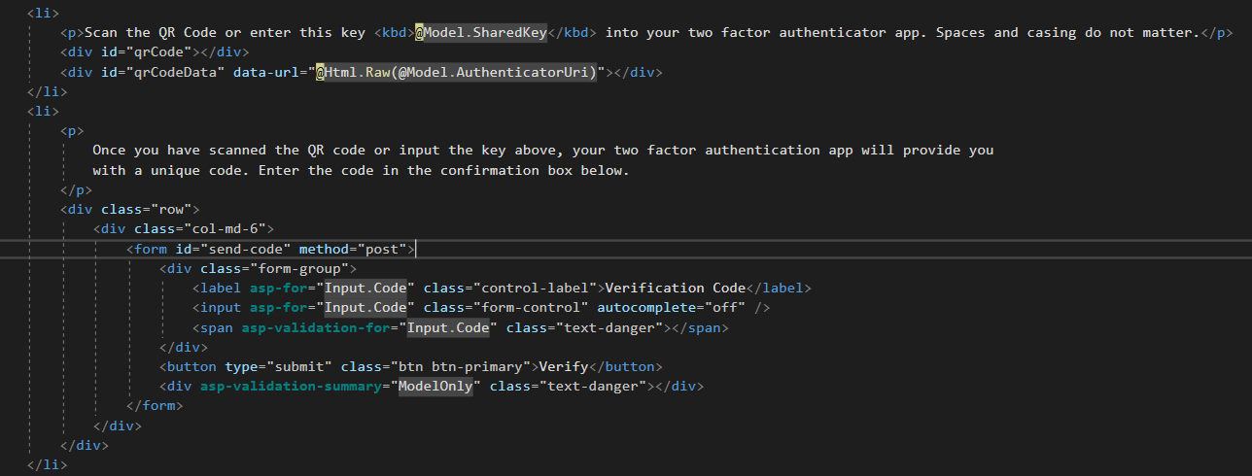
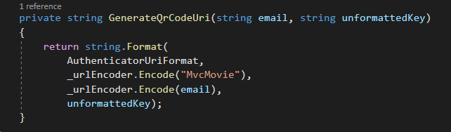
2 Factor Authentication
2 Factor Authentication is built into the Identity service for ASP.Net.
This has been enhanced using the QRCode for JavaScript library by David Shim available under the MIT Open Source License.

Slide 23
Pages Locked Behind Logins
Some pages require authentication to access.
The database administration page requires a specific user.

Slide 24
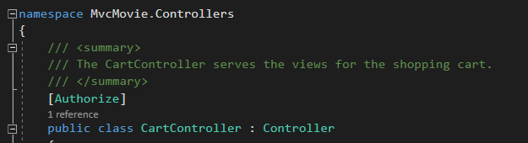
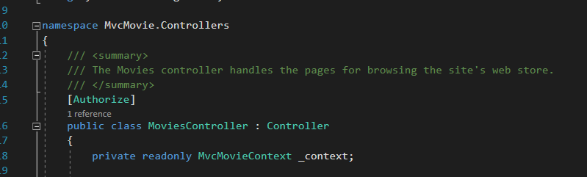

Slide 25
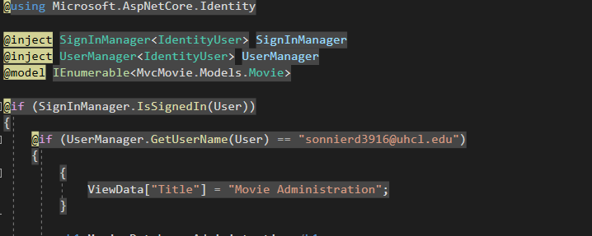
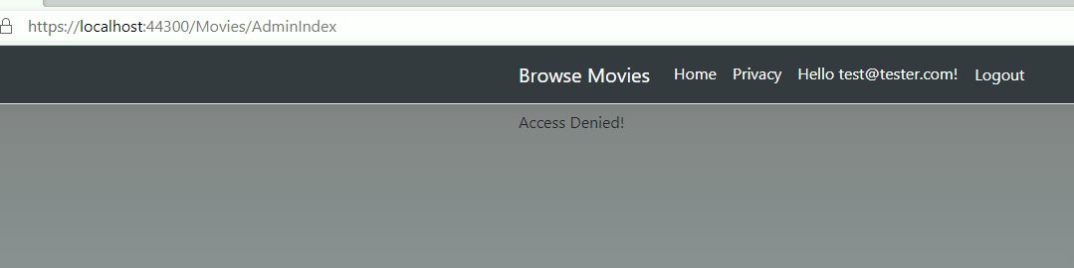
Database Administration via Web Interface with User Access Control

Slide 26
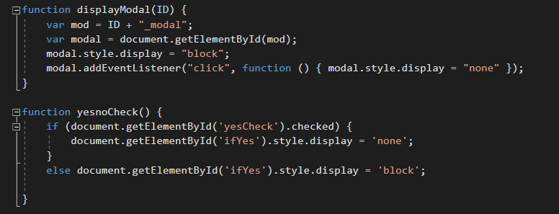
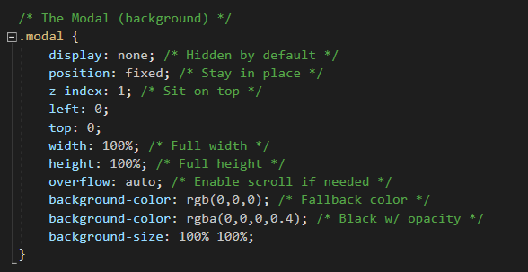
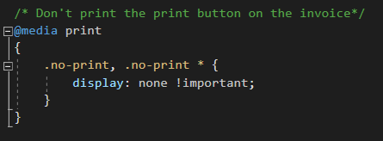
Classic Look with Modern Elements

Slide 27
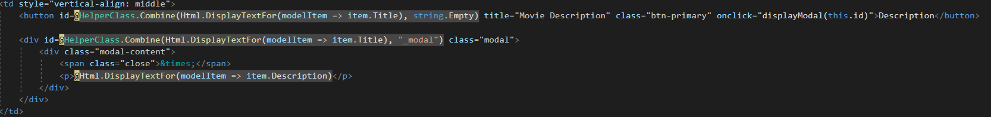

Modal Displays for Trailers and Plots

Slide 28

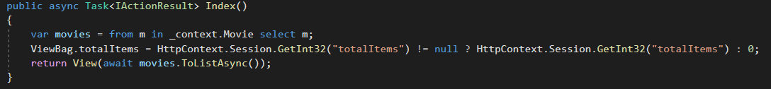
Cart Quantity Indicator in Header
ViewData[“totalItems”] and ViewBag.totalItems refer to the same value and are different means of referring to it.

Slide 29
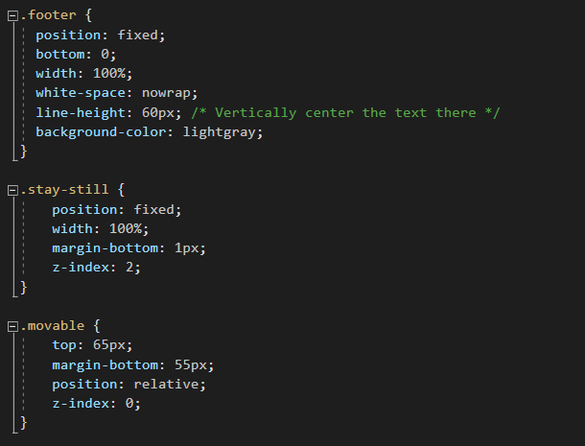
Header and Footer are Fixed
Allows page contents to scroll behind the header and footer while keeping those visible on screen at all times. Allows quick access to main menus, the shopping cart indicator and access to the cart itself.

Slide 30
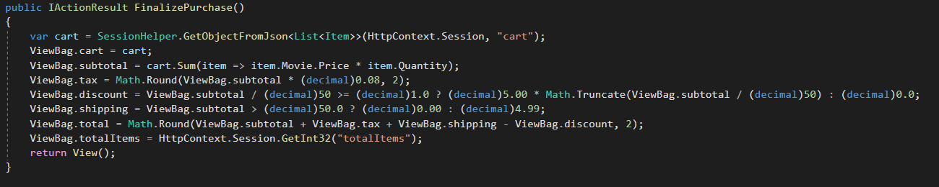
Shopping Cart Logic
Subtotal, taxes, shipping charges, discounts and final price are all automatically
calculated on the fly as new items are added or removed from the cart.

Slide 31
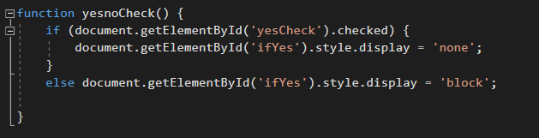
Separate Billing and Shipping Addresses
Code hides the Shipping Address portion of the form unless the user selects it. If the user only inputs a billing address it is used for shipping. If not, separate addresses are captured.

Slide 32
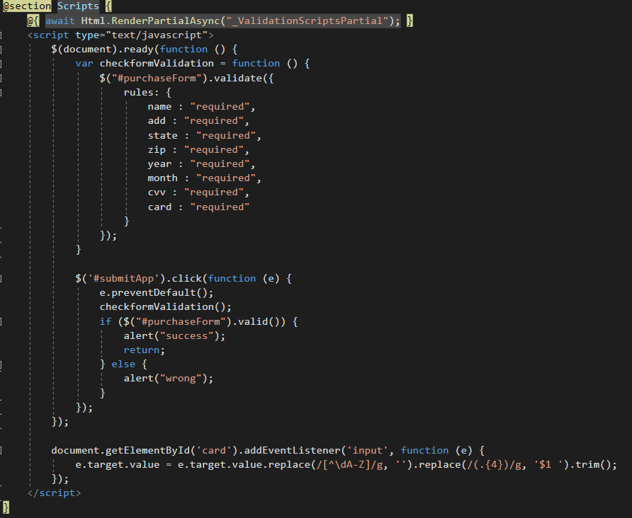
Form Validation
jQuery is used to validate the form for purchase inputs.
All rules validate inputs defined in the HTML.

Slide 33
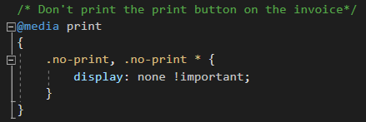
Printable Invoice(Button does not print)

Slide 34


Session Handling – Cookies and Automatic Cleanup of Session

